Slide 1
Device For Women’s Safety...
By Team - Encrypters

Slide 2
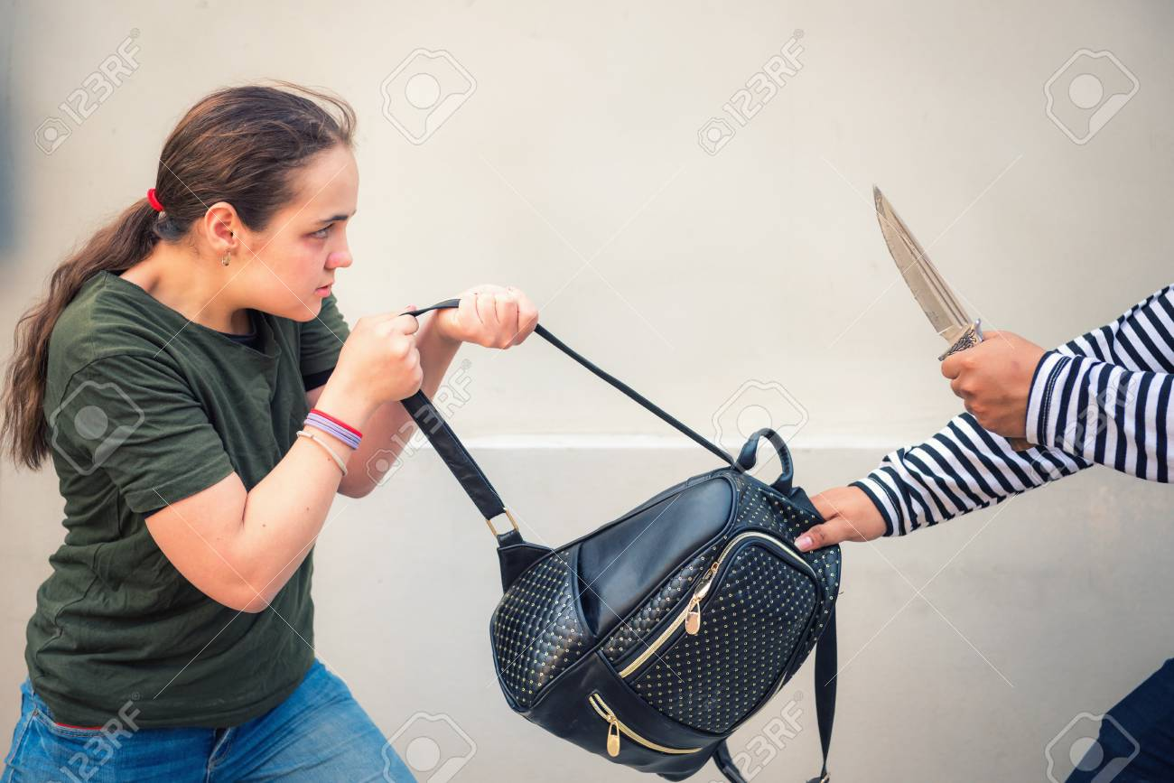
Kidnapping
Woman kidnapped by kidnappers.He loved soccer, but feared he had no way to talk to a coach or teammates.

Slide 3

Selling your idea
We have created a device that is for safety purpose. This device is look like your normal wearable fit-band.

Slide 4


Features:-
Choose one approach to grab the audience’s hhovhvvghhvhhhhvvvjj
Panic Trigger
Password Security .
Simple and Easy to Use.
Location availability

Slide 5
Current Available Option :-
Spray
Smell band
SOS option in mobiles.

Slide 6
Just one!
This is Quick and Easy to Use.
You don’t have to worry about calling to 112 and then press 1 to make emergency call.
Just press the trigger in emergency situation your Alert! Message is send to your relatives as well as to police station.

Slide 7
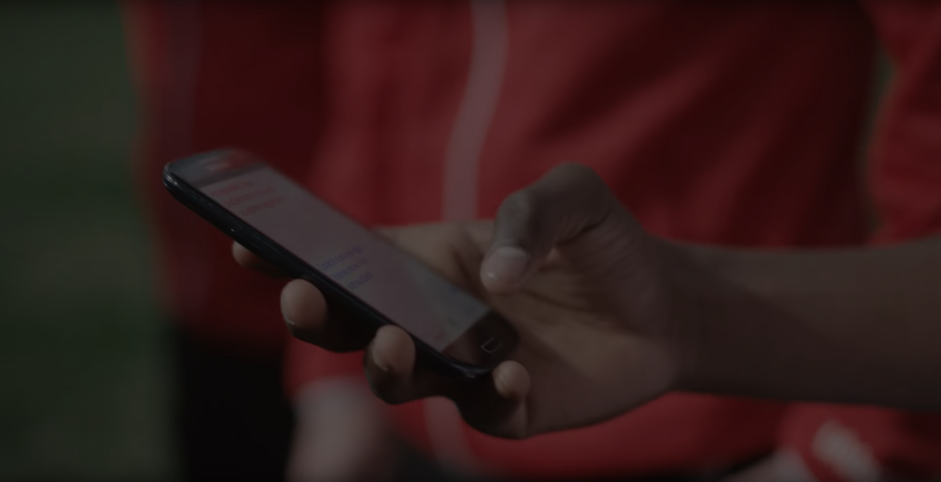
Calling or Messaging can take Time.
So, this can be useful product as well as cheaper in cost.

Slide 8
----------------- ARCHITECTURE ------------------
In our idea, we are going to use various technologies and hardware components. Our idea is that we make a prototype of an wearable device that help in safety and health too. We are using IOT to make prototype to contribute towards the safety of women.

Slide 9
Software used:-
1. Arduino IDE
2.Firebase
Hardware used:-
1.Arduino
2.Node MCU
3.OLED
4.Keypad
5.Jumper wires

Slide 10
WORKING MODEL OF DEVICE
Suppose a women is using our device means weared on his hand and suppose she is going to party in meanwhile kidnappers kidnaps the women and now women has not to worry more because she has safety wearable device with him. She pressed the panic button and the message is sent to 5 - 10 relatives minimum and to nearby Police station with proper real - time location. Suppose women is kidnap in kurukshetra and button is pressed in karnal then, in which circle button is pressed that circle's POLICE STATION receive the message in this case karnal.
Through this women become safe and if someone try to misuse it then we have password encryption to avoid it. if someone pressurize on it then also automatic message was send. Opened only by password and closed by it.

Slide 11
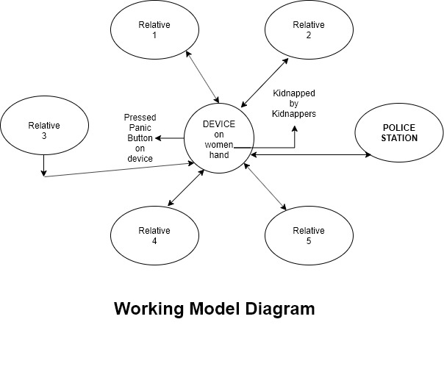
Software used:-
1. Arduino IDE
2.Firebase
Hardware used:-
1.Arduino
2.Node MCU
3.OLED
4.Keypad
5.Jumper wires

Slide 12
Positive Feature:-
Trigger Option
Visual screen
Security

Slide 13

Please ask your Query ?
Thank you,
Team-Encrypters

